Slide 1


Oracle database
Lecture 11

Slide 2

Today’s Agenda
Functions In Oracle
The DUAL Table
Various DATE Functions
Date Arithmetic

Slide 3
Functions In Oracle
A Function is a named block of code designed to achieve a particular task and just like a programming language , the Oracle database too has a huge collection of predefined functions.
These functions are further sub-divided into following categories:
Date Functions
String Functions
Numeric Functions
Conversion Functions
Group Functions
Miscellaneous Functions

Slide 4
The Dual Table
To understand the DUAL table , try to predict the output of the following query:
Select 2+2 from Students;
You might think that the above query is wrong and will give error. But it is not so.
The query is perfectly valid and will return 4 because Oracle permits us to write expressions or function calls with the Select command .

Slide 5
The Dual Table
The only problem is that the output 4 will be returned as many times as there are rows in the table.
So if we imagine that our STUDENTS table contains 6 rows , then the output will be:
2+2
==========
4
4
4
4
4
4

Slide 6
The Dual Table
To overcome this problem we have 2 solutions:
Create a table with just one row and then use it for such general purpose queries
OR
Use the DUAL table provided by Oracle for such situations
The DUAL table is a special table that belongs to the user SYS but it is accessible to all users.
It has just one column named DUMMY with the data type VARCHAR2 and contains one row with a value X.

Slide 7
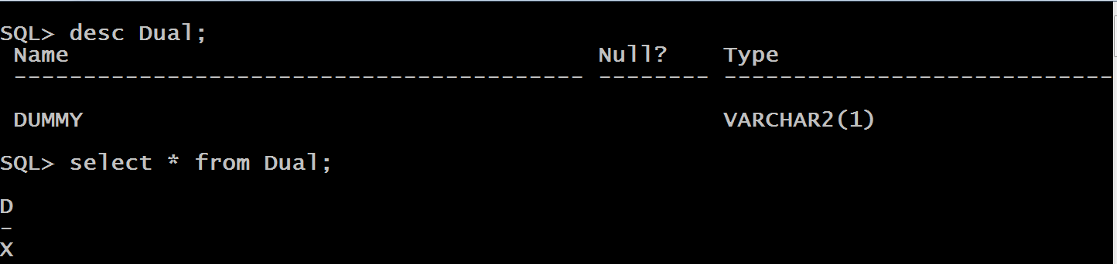
The Dual Table
This can be verified from the following screenshot.
So for all our general purpose queries and function calls we will be using DUAL

Slide 8
Date Functions In Oracle
Given on next slide are the most commonly used Oracle Date Functions .
These functions helps us perform various operations on Dates as well as handle date and time data easily and more effectively.

Slide 9
Date Functions In Oracle
Function | Description
sysdate() | Returns the current system date and time
add_months(date,n) | Returns a date value after adding ‘n’ months to the date ‘x’.
last_day(date) | Returns the last day of the month of a specified date.
next_day(date,str) | Get the first weekday that is later than a specified date.
months_between(date1,date2) | Return the number of months between two dates.
greatest() | Returns the greatest date amongst a set of dates
least() | Returns the least date amongst a set of dates
extract() | Extracts a specific component from a date
.

Slide 10
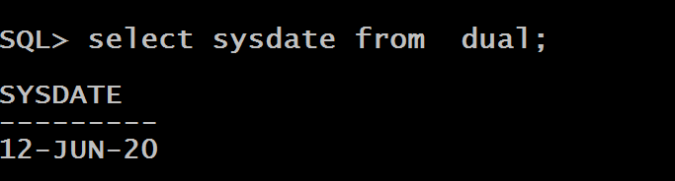
The Function Sysdate()
Return the current system date and time of the operating system.

Slide 11
The Function Add_months()
This function adds a number (n) representing month to a date and returns the same day n months away.
Syntax
ADD_MONTHS(date_expression, month)
Return Value
If date_expression is the last day of the month, the resulting date is always the last day of the month e.g., adding 1 month to 29-FEB-2020 will result in 31-MAR-2020, not 29-MAR-2020.
Otherwise, the function returns a date whose day is the same as the day component of the date_expression

Slide 12
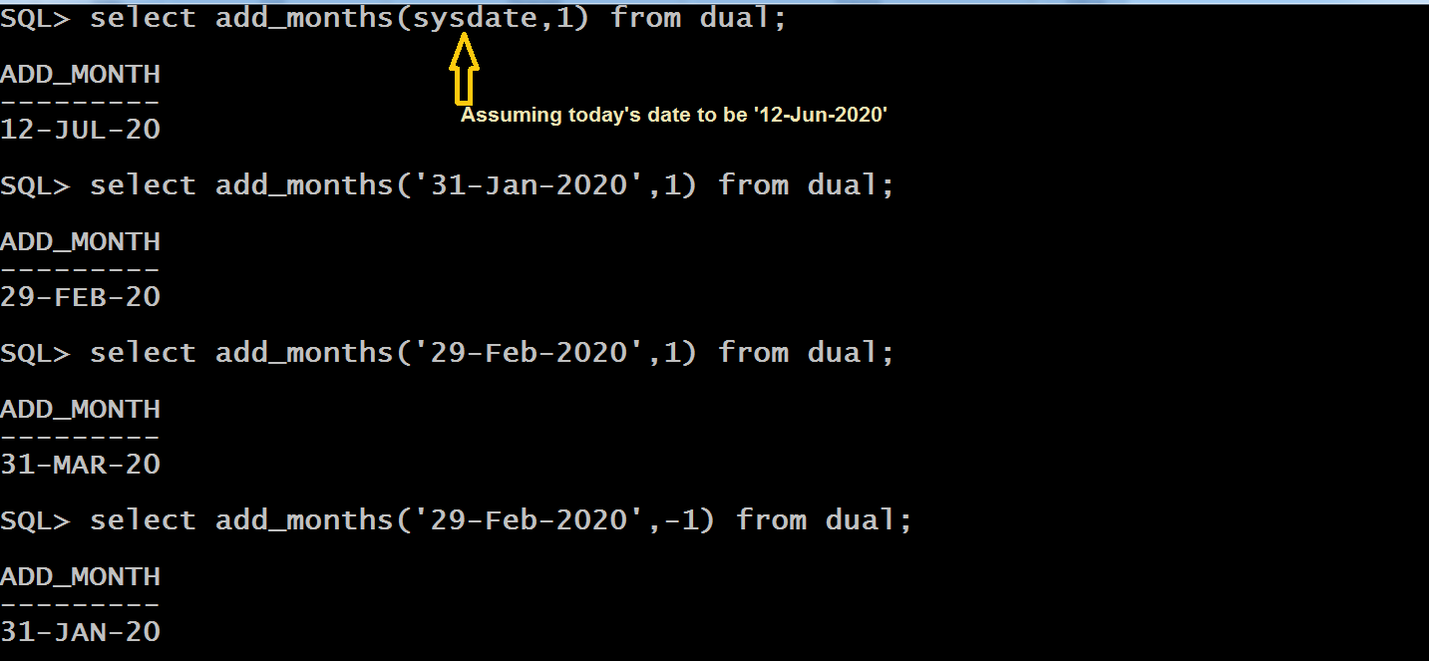
The Function Add_months()

Slide 13
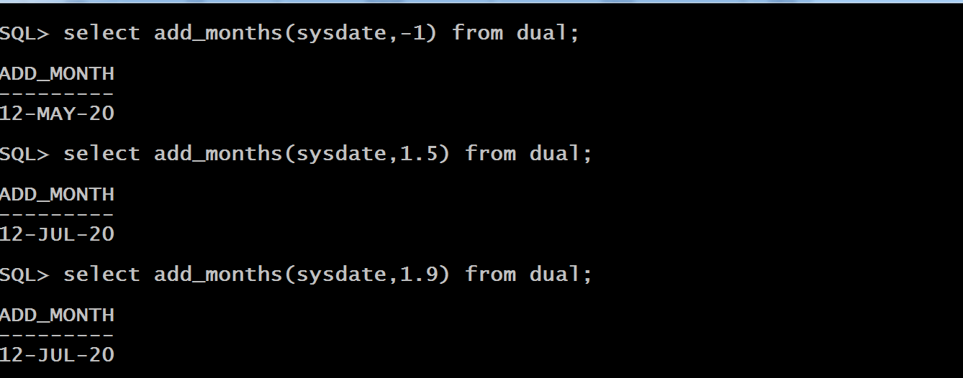
The Function Add_months()

Slide 14
The Function Last_day()
This function takes a DATE argument and returns the last day of the month of that date.
Syntax
LAST_DAY(date)
Return Value
Always returns a DATE value that represents the last day of the month of that input date.

Slide 15
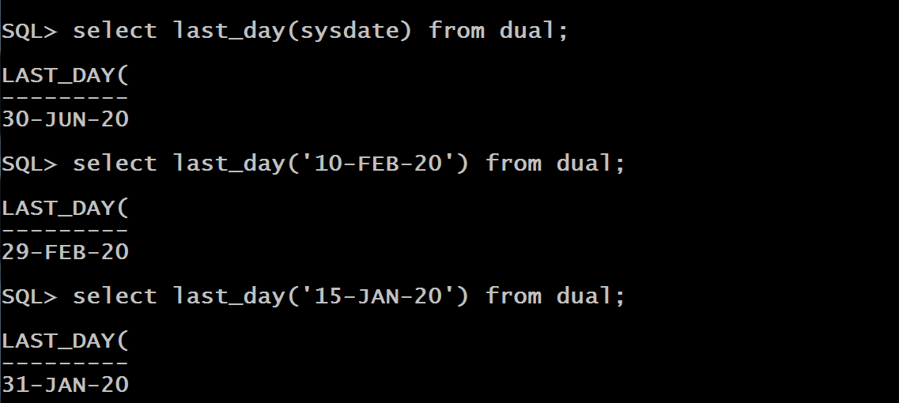
The Function Last_day()

Slide 16
The Function Next_day()
This function returns the date of the first weekday specified by day name that is later than the given date.
Syntax
NEXT_DAY(date,weekday)
The weekday can be full name e.g., Tuesday or abbreviation e.g., Tue.
Return Value
Always returns a DATE value that represents the next weekday after the date.

Slide 17
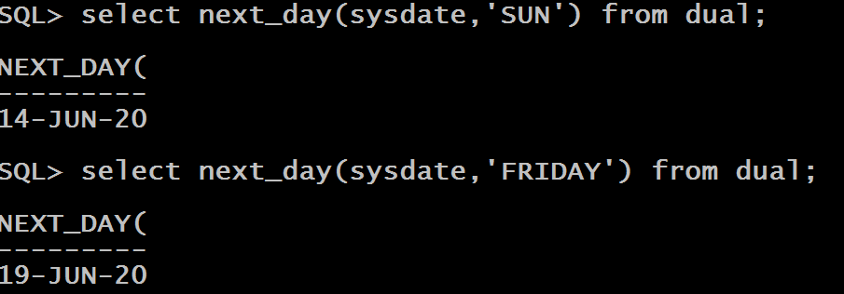
The Function Next_day()

Slide 18
The Function Months_between()
This function returns the number of months between two dates.
Syntax
MONTHS_BETWEEN (date1, date2)
Return Value
If date1 comes after date2, then MONTHS_BETWEEN returns a positive number.
If date1 comes before date2, then MONTHS_BETWEEN returns a negative number.
If date1 and date2 both fall on the last day or same day of their respective months, then MONTHS_BETWEEN returns a whole number (no fractional component).
If date1 and date2 are in different months and at least one of the dates is not a last day in the month, MONTHS_BETWEEN returns a fractional number.
The fractional component is calculated on a 31-day month basis

Slide 19
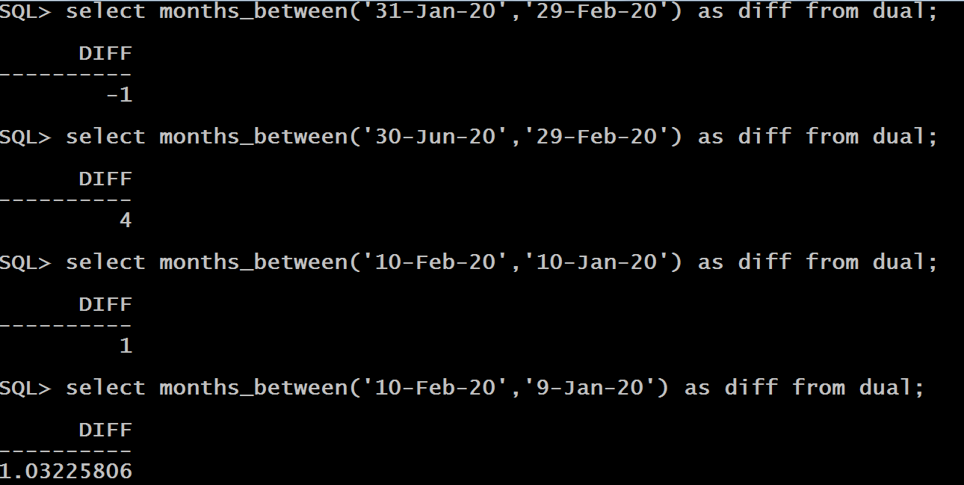
The Function Months_between()

Slide 20
The Function Greatest()
This function returns the greatest date from the set of dates passed as argument.
Syntax
GREATEST(date1, date2, . . . . .)
Return Value
The date which is greater.
A greater date is one which falls after the other dates.

Slide 21
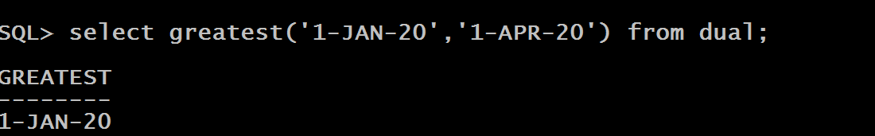
The Function Greatest()
The output is very surprising . How can 1-JAN be greater than 1-APR ?.
This is because in Oracle the function greatest() is overloaded to work on Numbers , Varchar2 as well as Date
So , in this case Oracle is assuming all the dates to be varchar2 and as we know ‘J’ is greater than ‘A’ , so 1-JAN is greater than 1-APR

Slide 22
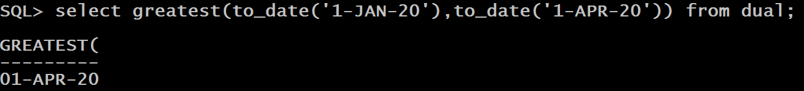
Solution
To solve the above problem , we must forcibly convert these dates to varchar2 and this is done by using a function called TO_DATE()

Slide 23
The Function Least()
This function returns the smallest date from the set of dates passed as argument.
Syntax
LEAST(date1, date2, . . . . .)
Return Value
The date which is smallest.
A smaller date is one which falls before the other dates.

Slide 24
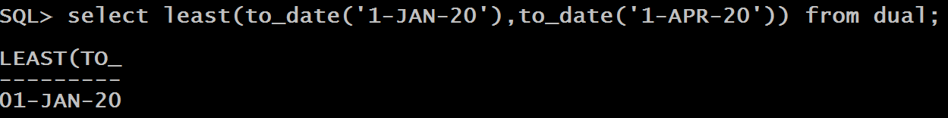
The Function Least()
The function least() is also overloaded so here also we must forcibly convert dates to varchar2 using the function TO_DATE()

Slide 25
The Function Extract()
This function extracts a specific component (year, month or day) from the date passed as argument.
Syntax
EXTRACT(<field> FROM <source_date>)
Field can be YEAR / MONTH / DAY
Return Value
Returns the value of the field of the source.

Slide 26
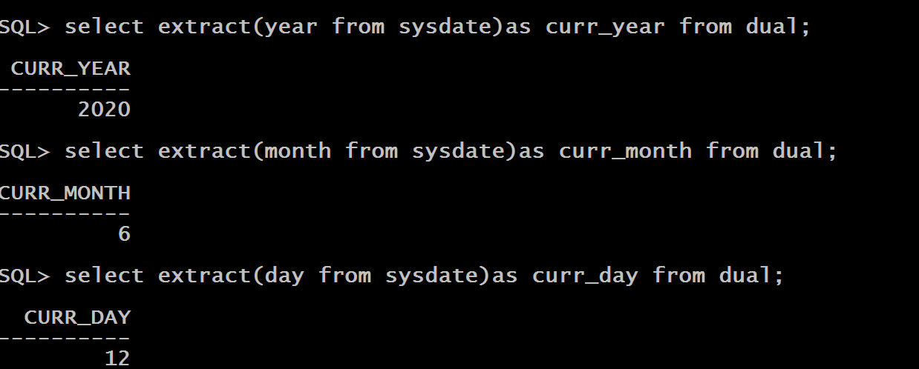
The Function Least()

Slide 27
Oracle Date Arithmetic
We can perform lot of arithmetic operations on DATE datatype.
These are :
Adding or subtracting a number to or from a date
Subtracting two dates to find the number of days between those
Adding hours to a date

Slide 28
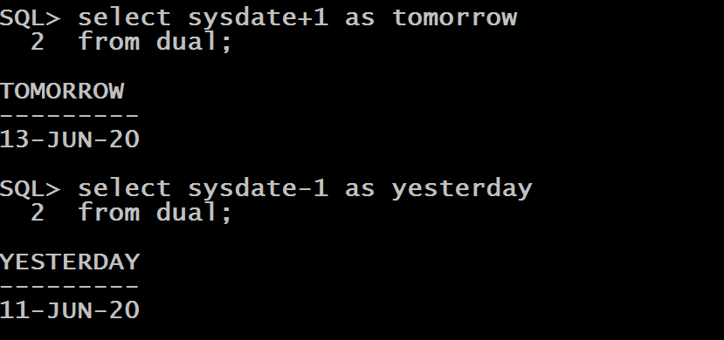
Adding And Subtracting Days
Adding or subtracting a number form a date always performs operation on the day part of the date

Slide 29
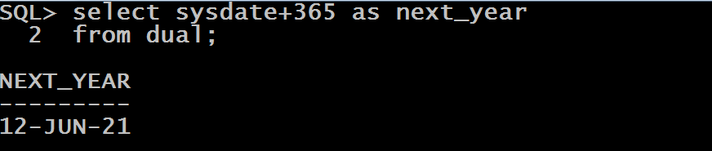
Adding Year

Slide 30
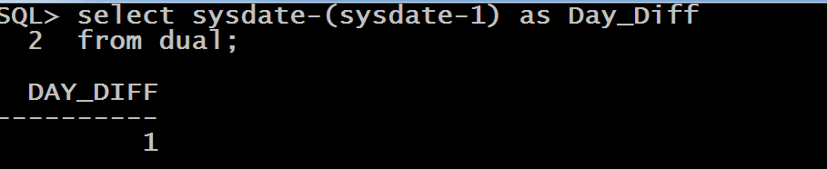
Subtracting 2 Dates
Subtracting two dates always returns number of days between them

Slide 31
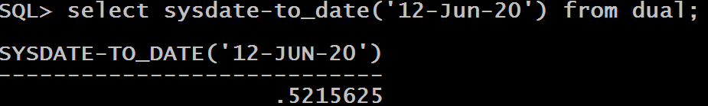
Guess The Output ?
Select sysdate-to_date(‘12-Jun-20’) from dual;
Surprised !!!
Many of us will expect the output to be 0 as both the dates are same , but it is not the case .

Slide 32
Reason
Why the result is not 0 ?
This is because the function sysdate stores time up to the current second while date constant like ‘12-Jun-20’ store time of midnight i.e 12:00:00 AM.
So the difference is the current time – midnight , converted into days.

Slide 33
Solution
To solve the above problem we must set the current time in sysdate to midnight 12:00:00 .
This is done by calling the function TRUNC() which accepts a DATE as argument and truncates it’s time part to midnight 12:00:00

Slide 34
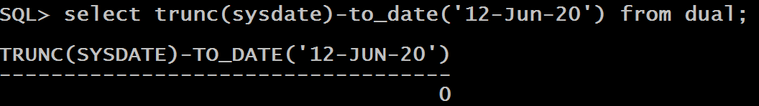
Solution

Slide 35
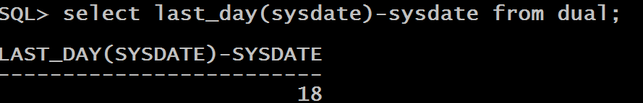
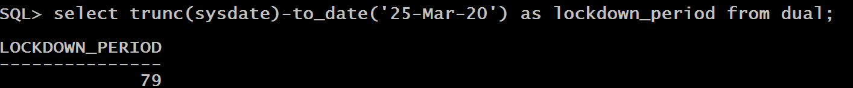
Queries
WAQ to display number of days remaining in the current month
WAQ to display number of days since lockdown

Slide 36
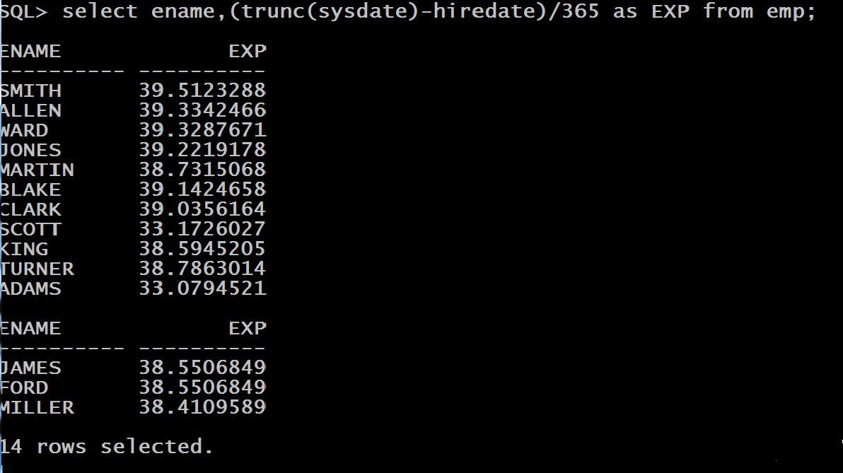
Queries
WAQ to display name of every employee along with no of years for which he has been working in the company

Slide 37
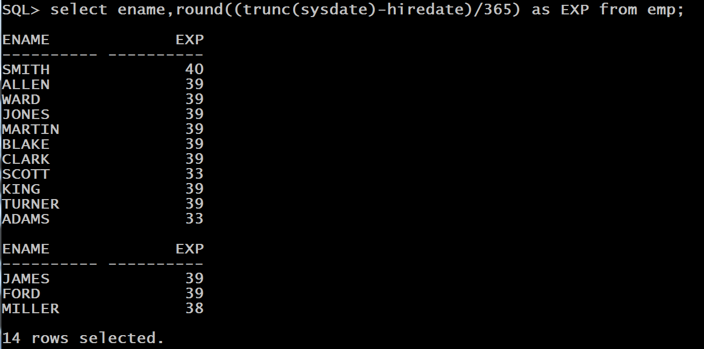
Queries
To convert the years into whole number we can use the function ROUND() which rounds off the fractional part.

Slide 38
Queries
Suppose you are hired on a new job today , but with a salary which is less than what you had expected . However the HR manager has promised to raise your salary on the first day of the next month after 6 months.
Find out:
Your increment date
No of days you have to wait for increment

Slide 39
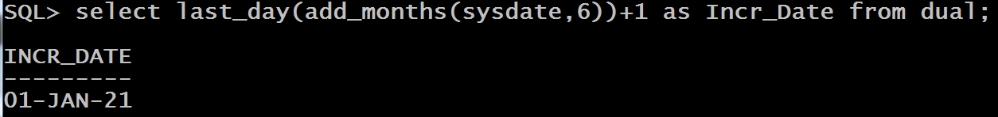
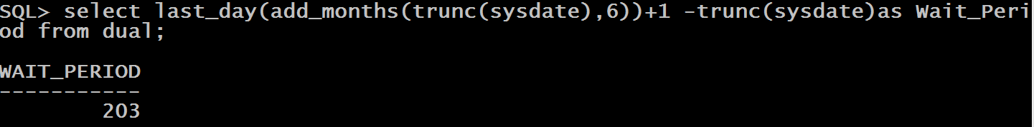
Queries

